Slide 1



DIYALA UNIVERSITY
COLLEGE OF ENGINEERING
DEPARTMENT OF COMMUNICATIONS ENGINEERING
Mathematics- II
$$5^{th }Lecture$$
First Year
lecturer
Wisam Hayder
2021

Slide 2
Vectors and the Geometry of Space
Three-Dimensional Coordinate Systems
To locate a point in a plane, two numbers are necessary.
We know that any point in the plane can be represented
as an ordered pair (a, b) of real numbers, where a is the x-
coordinate and b is the y-coordinate.
For this reason, a plane is called two-dimensional. To locate a point in space, three numbers are required.
We represent any point in space by an ordered triple (a, b, c) of real numbers.

Slide 3
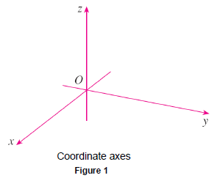
Vectors and the Geometry of Space
In order to represent points in space, we first choose a fixed point O (the origin) and three directed lines through O that are perpendicular to each other, called the coordinate axes and labeled the x-axis, y-axis, and z-axis.
Usually we think of the
x- and y-axes as being
horizontal and the z-axis
as being vertical, and we
draw the orientation of
the axes as in Figure 1.

Slide 4
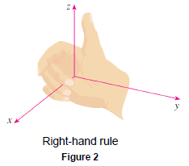
Vectors and the Geometry of Space
The direction of the z-axis is determined by the right-hand rule as illustrated in Figure 2:
If you curl the fingers of your right hand around the z-axis in the direction of a 90° counterclockwise rotation from the positive x-axis to the positive y-axis, then your thumb points in the positive direction of the z-axis.
Notes:
aaa

Slide 5
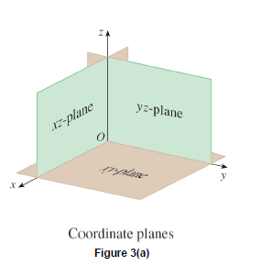
Vectors and the Geometry of Space
The three coordinate axes determine the three coordinate planes illustrated in Figure 3(a). The xy-plane is the plane that contains the x- and y-axes; the yz-plane contains the
y- and z-axes; the xz-plane contains
the x- and z-axes.
These three coordinate planes
divide space into eight parts,
called octants. The first octant,
in the foreground, is determined
by the positive axes.

Slide 6
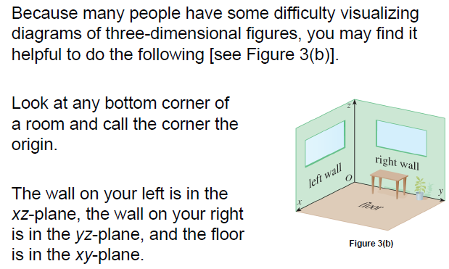
Vectors and the Geometry of Space
Notes:
aaa

Slide 7
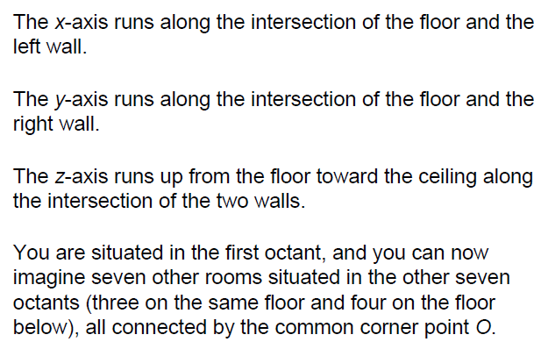
Vectors and the Geometry of Space
Notes:
aaa

Slide 8
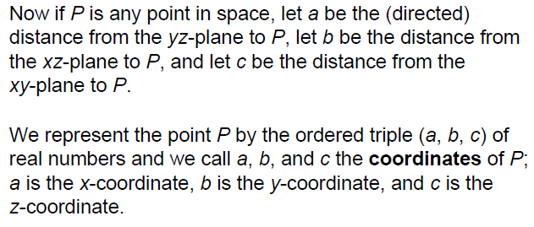
Vectors and the Geometry of Space

Slide 9
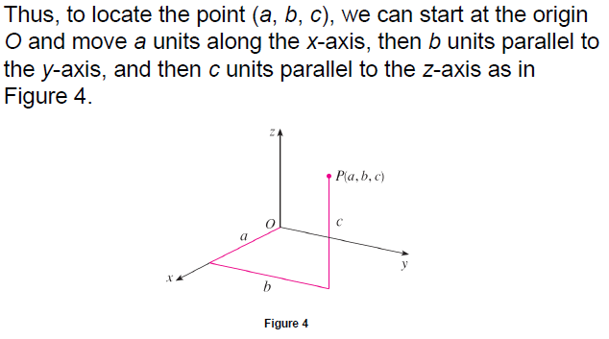
Vectors and the Geometry of Space

Slide 10
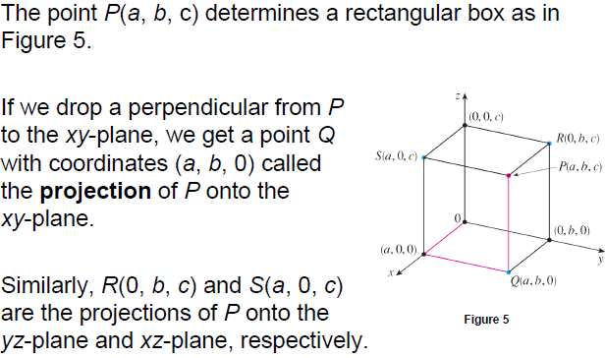
Vectors and the Geometry of Space
Notes:
aaa

Slide 11
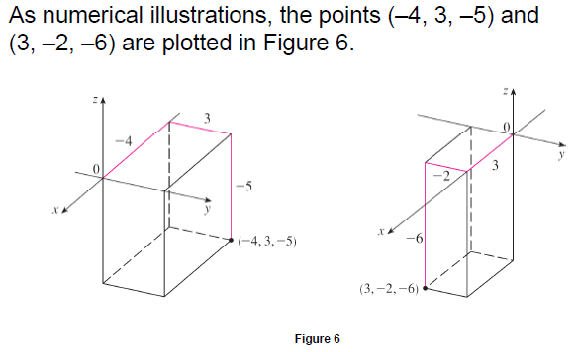
Vectors and the Geometry of Space
Notes:
aaa

Slide 12
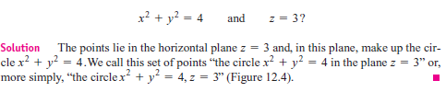
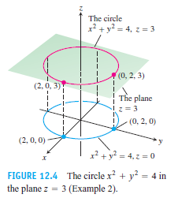
Vectors and the Geometry of Space
Example 1 What points P(x, y, z) satisfy the equations
Notes:
aaa

Slide 13
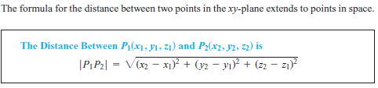
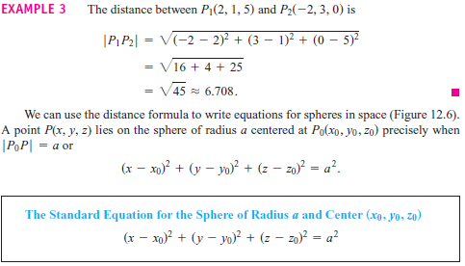
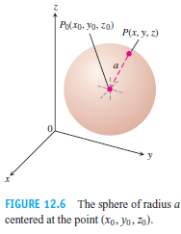
Vectors and the Geometry of Space
Distance and Spheres in Space
Notes:
aaa

Slide 14
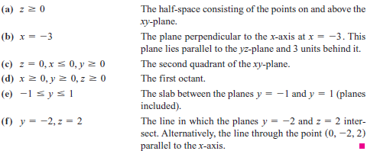
Vectors and the Geometry of Space
Example 2 We interpret these equations and inequalities geometrically.

Slide 15
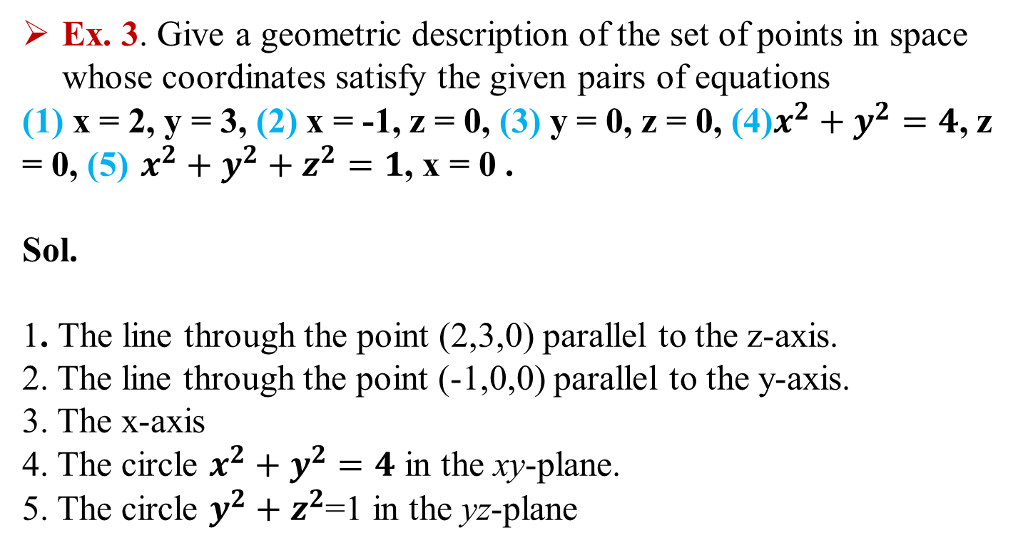
Vectors and the Geometry of Space
Ex. 3. Give a geometric description of the set of points in space whose coordinates satisfy the given pairs of equations
(1) x = 2, y = 3, (2) x = -1, z = 0, (3) y = 0, z = 0, (4)$x^{2}+y^{2}=4$, z = 0, (5) $x^{2}+y^{2}+z^{2}=1$, x = 0 .
Sol.
1. The line through the point (2,3,0) parallel to the z-axis.
2. The line through the point (-1,0,0) parallel to the y-axis.
3. The x-axis
4. The circle $x^{2}+y^{2}=4$ in the xy-plane.
5. The circle $y^{2}+z^{2}$=1 in the yz-plane

Slide 16

Vectors and the Geometry of Space
Ex3. Describe the sets of points in space whose coordinates
satisfy the given inequalities or combinations of equations and
inequalities.
1.
2.
Sol.
(a) The first quadrant of the xy-plane.
(b) The fourth quadrant of the xy-plane.
2. (a) The slab bounded by the planes x = 0 and x = 1
(b) The square column bounded by the planes x= 0, x =1, y =0, y = 1
(c) The unit cube in the first octant having one vertex at the origin

Slide 17


Vectors and the Geometry of Space
Ex 4. Find the centers and radius of the spheres.
1.
2.
Sol.
center (-2, 0, 2), radius $2\sqrt{2}.$
center (1, $\frac{−1}{2}, −3$ ), radius 5

Slide 18
Vectors
Component Form
A quantity such as force, displacement, or velocity is called a vector and is represented by a directed line segment (Figure 12.7).
The arrow points in the direction of the action and its length gives the magnitude of the action in terms of a suitably chosen unit.

Slide 19
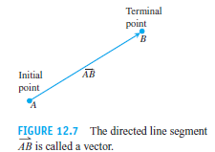
Vectors
For example, a force vector points in the direction in which the force acts and its length is a measure of the force’s strength; a velocity vector points in the direction of motion and its length is the speed of the moving object

Slide 20
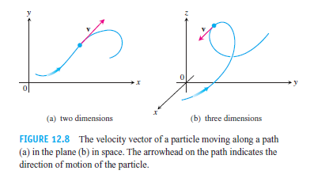
Vectors
Figure 12.8 displays the velocity vector v at a specific location for a particle moving along a path in the plane or in space.

Slide 21

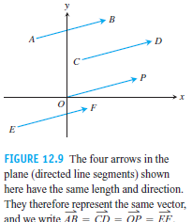
Vectors
The arrows we use when we draw vectors are understood to represent the same vector if they have the same length, are parallel, and point in the same direction (Figure 12.9) regardless of the initial point.

Slide 22
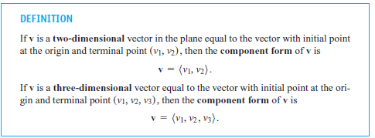


Vectors

Slide 23
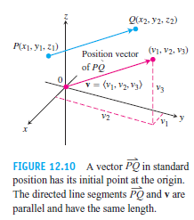

Vectors

Slide 24
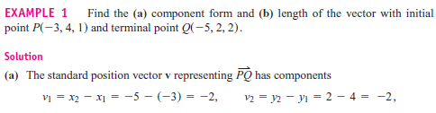
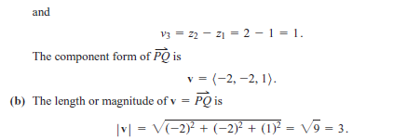
Vectors

Slide 25
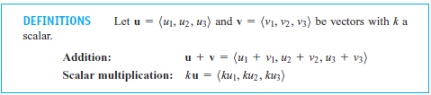
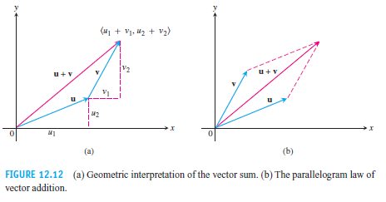
Vectors
Vector Algebra Operations

Slide 26
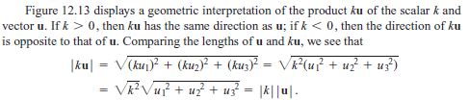
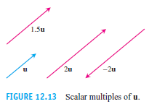
Vectors

Slide 27
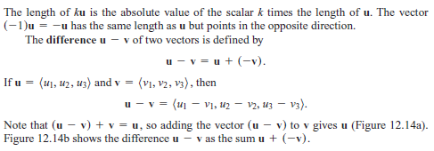
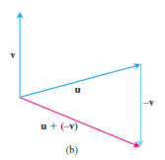
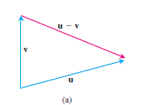

Vectors

Slide 28
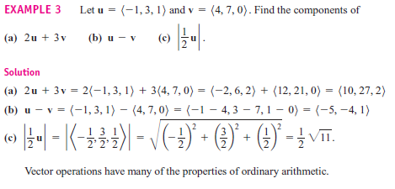
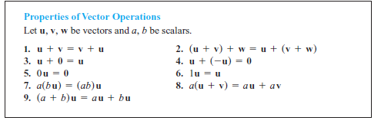
Vectors

Slide 29
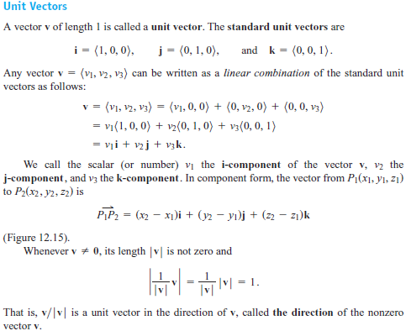
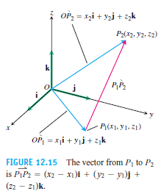
Vectors

Slide 30
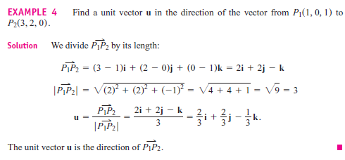
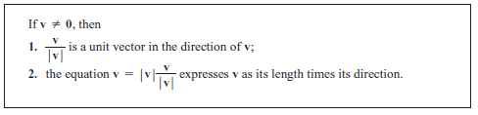
Vectors

Slide 31
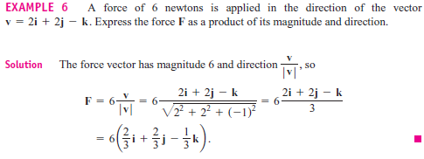
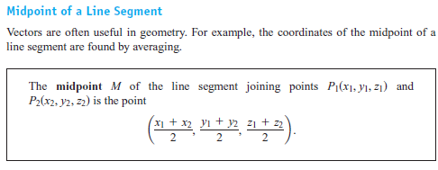
Vectors

Slide 32

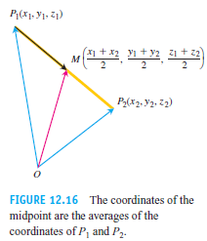
Vectors

Slide 33
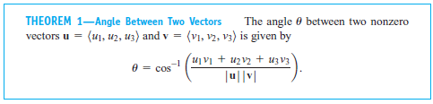

Vectors
The Dot Product

Slide 34

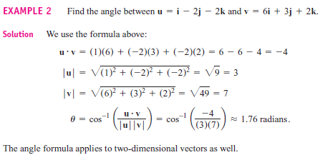
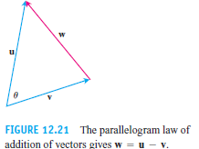
Vectors

Slide 35
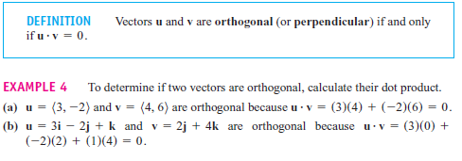

Vectors
Perpendicular (Orthogonal) Vectors

Slide 36
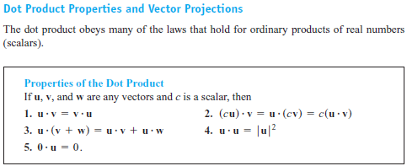
Vectors

Slide 37
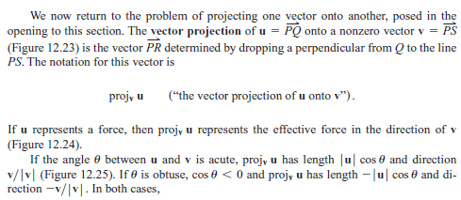

Vectors

Slide 38
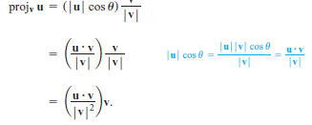
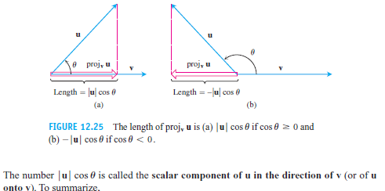
Vectors

Slide 39
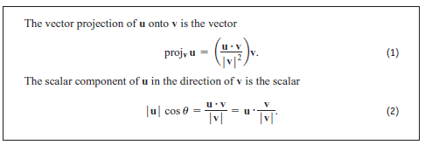
Vectors

Slide 40

Vectors

Slide 41



Vectors

Slide 42

Vectors

